Slide 1
Finding & Keeping Clients
Discover Santa 2016
#KringleReunion
July 8, 2016
Dan Greenleaf
ImSanta.Org, Manchester, NH

Slide 2
For PowerPoint & Resource Materials
www.ImSanta.Org/ds2016/clients
Password: ds2016

Slide 3
Win the clients you want
& keep the ones you have.
Package, price & promote your services to fill your schedule.
Notes:
Individual

Slide 4
Win the clients you want…
You Decide. It’s Up To You.
Purpose
Types of Work
Preferred Clients
Location
Schedule
Price
Set Goals & Priorities
Focus time, energy & money on top priorities.
Identify Target Groups
Develop activities specific to target group.

Slide 5
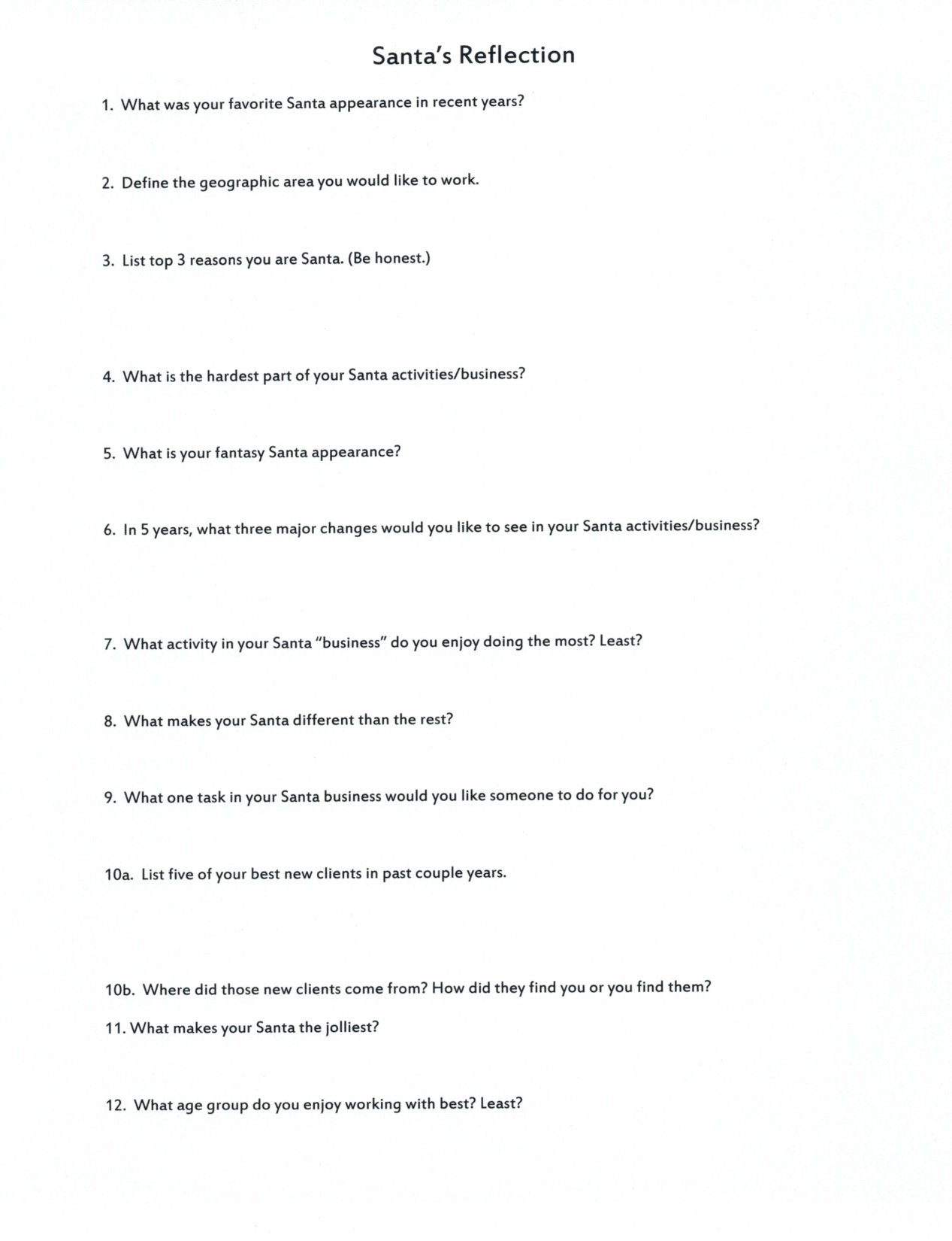

Slide 7
Focus by Target Groups
Describe
Demographics
Geography
Motivators & Barriers
Services Wanted & Needed
Decision Makers
How to Reach Them
Where to Look for Santa
Use past, current & prospects for research.
List Specific Individuals
Objectives
Action Steps
Evaluation

Slide 8
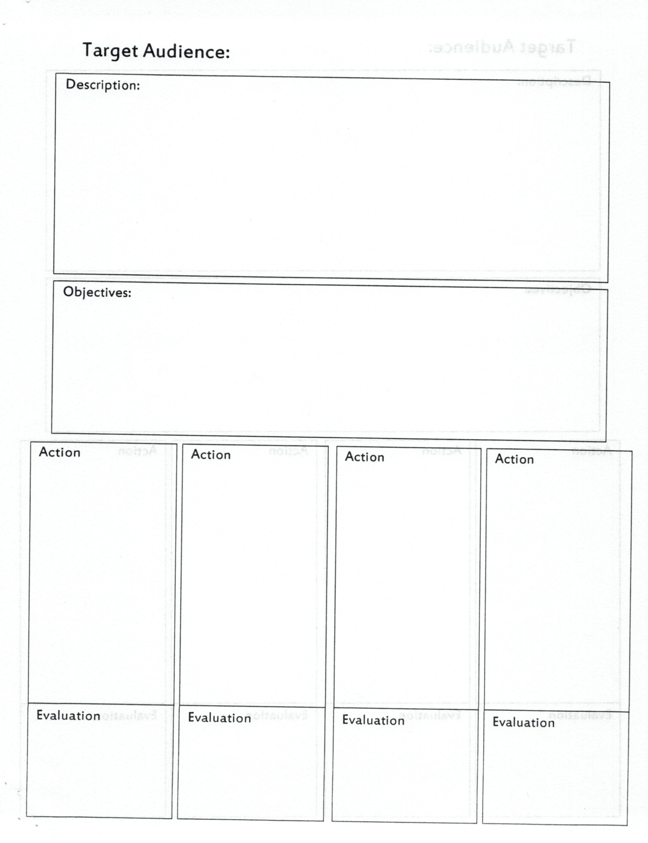

Slide 9
Package, price & promote… Pricing Your Services
Set Hourly Rate
Understandable
Easy to Quote
Allows Flexibility
Treats Everyone Fairly
Can differ by day, time or season. CE & CD.
Rate Based On:
Experience
Time Available
Services Offered
Revenue Goal
Competitors’ Fees

Slide 10
Package, price & promote…
Promote Rates
Positions You in Market
Shows Fairness
Educates Prospects
Offers Options
Eliminates Lowballers

Slide 11
Package, price & promote… Value Your Value
Top End Pricing
Supply & Demand
Limited Season
Get Better Clients
Work Less for More
Get What You Pay For
You Can Always Negotiate a Lower Price
Invoice Full Value
(Even donated services)
Charge for Add-Ons
Travel
Mrs. Claus & Helpers
Special Services
Chair or Equipment
Give-aways

Slide 12
Package, price & promote… Use Pricing as a Sales Tool
Discount Options
Multiple Hours
Early Bird Booking
Return Client
Charity/Non-Profit
New Client
Friends & Family
Off Season
Off Peak Days & Hours
Alternative Payment
Barter Services
Gift Certificates
Half Cost to Them
Avoid Restrictions
Membership
Marketing Opportunity
Contact List
Cooperative Activity

Slide 13
Package, price & promote… Focus Your Services
Tailor Services for Each Target Group
Target Group Needs
Overcome Obstacles
Tweak Current Offers
Your Goals & Priorities
Fill Empty Schedule
Differ from Competitor
Typical Services
Hour-Long Family Visit
Christmas Eve Drop-In
Meet & Greet
Photos with Santa
Holiday Party
Special Event
Business Appearance
Fund-raising Event

Slide 14
Package, price & promote… Create Unique Offerings
Family Visits
Cookies & Milk
Storytime & Tuck-In
Birthday Delivery
Photo Session
Homework Help
Schools
Public Service Project
History Lesson
PTA/PTO Event
Business
Toy Primer for Parents
Craft Time
Book Talk
Purchase Delivery
Employee Thank You
Staff Lunch Delivery
Own Photo Booth
Performance
Donation Collection

Slide 15
Package, price & promote… Reaching New Prospects
Develop specific activities for each target group.
Think like the prospect. Where will they look?
Do the same search. Take the same steps.
Make sure you are there when they look.
Find most direct way to reach them.
Create a message that matches what they want.
Make it easy for them to contact you & get info.

Slide 16
Package, price & promote… In Search of Santa
Web Search
Craigslist
Booking Sites
GigSalad.com
GigMasters.com
Thumbtack.com
Booking Agency
Nationwide Santas
Santa Tim
Local Agents
Classified Ads
Referrals
Directories
Yellow Pages
SantaClausGuide.com
Organizations
Chamber of Commerce
IBRBS, Local Groups
Personal Contact
Connected Businesses
Venues
DJs
Photographers
Caterers

Slide 17
Package, price & promote… In Search of Clients
Past Clients
1st Bookings
Thank You
Referrals
Prospects
2nd Bookings
Referrals
Target Audiences
Personal Visit
Direct Mail
Phone Call
Friends & Family
Connected Businesses
Promotional Materials
Commission
Networking
Business Groups
Organizations
Community Events
Speaking
Volunteer
Social Media
Media

Slide 18
Package, price & promote… Santa’s Marketing Tool Kit
Name
Profile
Photos
eMail
Contact Lists
Business Cards
Give-Aways
Brochure
Webpage
- Facebook Page
Flyers
Social Media
Classifieds
Prospect Letter
Contract
Thank You

Slide 19
Package, price & promote… Give Clients What They Want
Client Wants to Know
How You Look
What You Do
Availability
Price
Experience
Personality
Safe
Reliable
Ability to Relate
Provide Clients With
Photos
Services Offered
Flexibility
Rates & Packages
Education
Experience
Related Clients
Background Check
Reviews

Slide 20
Win the clients you want… Book the Client
Once you make contact, close the contract.
Prequalified from information provided.
Make it easy to contact & book.
1. Determine services, length, date & details.
2. Agree on a Price
3. Provide a Written Contract
4. Receive a Retainer Payment

Slide 21
Win the clients you want… Booking Process
Intake Form
Client Information
Contact Info
Event details
Budget
Source of Lead
Booking Record
Gather Info for Selling
Build Prospect List
Offer What They Want
Match to Info Received
Focus on What Can Do
Match to Request
Don’t Focus on You
Keep Schedule Flexible
Match Offer to Budget
Deal with Objections
Close – Contract
Retainer to Secure

Slide 22
…keep the ones you have. Encouraging Return Business
Basic Customer Service
Keep Clients Happy
Prompt Response
Good Communication
Deliver What Promised
Accommodate Request
Give Extra
Evaluate Results
Ask at End
Survey Later
Survey Clients
Overall Satisfaction
Performance
Areas for Improvement
Changes to Make
What to Keep
Booking System
Communications
Book Next Year
Recommend to Friends
Use for Off Season Events

Slide 23
…keep the ones you have. Build a Relationship
Make Them Special
Priority Booking
Past Client Discount
Thank You Gift
Feature Photos
Social Media Mention
Be a Customer
Give Referrals
Request Reviews
Ask for Reference
Year Round Contact
Thank You Note
Occasion Cards
Birthday
Anniversary
Graduation
Ask for Suggestions
Notices of Events
Ask for & Give Photos
Social Media Contact

Slide 24
Merry Christmas
Dan Greenleaf
ImSanta.Org,
Manchester, NH
Santa@ImSanta.Org
424-2SANTA1
www.Facebook.com/ImSanta.Org
www.Facebook.com/SantaDanGreenleaf
Twitter: @SantaCKringle
LinkedIn: Santa Dan Greenleaf
www.SantaCKringle/tumblr.com

