Slide 1
Marketing Your Santa Services
Discover Santa 2016
#KringleReunion
July 9, 2016
Dan Greenleaf
ImSanta.Org, Manchester, NH

Slide 2
For PowerPoint & Resource Materials
www.ImSanta.Org/ds2016/marketing
Password: ds2016

Slide 3
Plan Ahead
Decide Goals
Define Services
Identify Target Audiences
Set Objectives
Schedule Actions
Gather Resources
Just Do It
All it takes is time and money!
Notes:
Individual

Slide 4
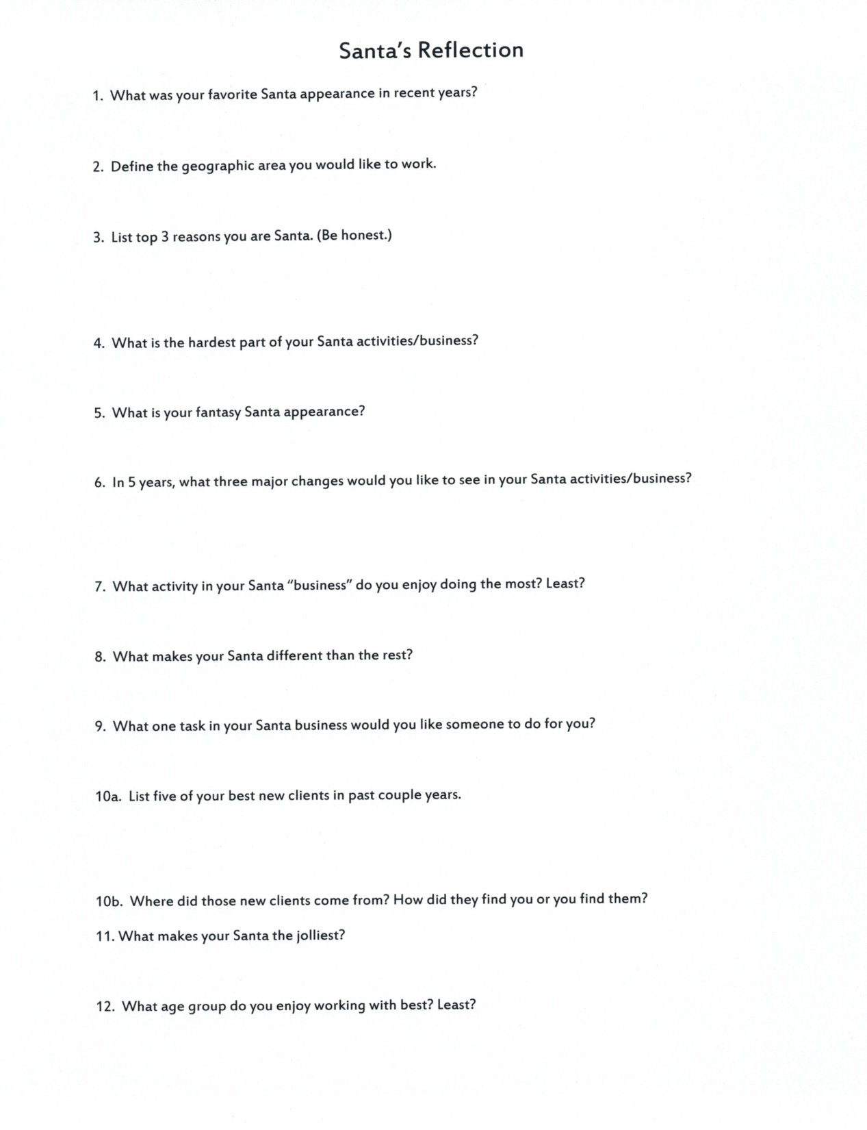

Slide 5
Define Goals
Goals
Broad
General
Blue sky
Become the go-to Santa for area media interviews.
Be busy throughout the season with appearances.
Make my Santa business profitable.
Limit amount of travel.
Objectives
Specific
Measureable
Attainable
Increase number of home visits by 25% over 2013.
Book at least 3 special event appearances.
Achieve equal number of weekday & weekend visits.
Earn $5000 in profit.

Slide 7
Identify Target Audiences
Who helps you reach your goals?
End User (Clients & Customers)
Gatekeepers (Media, Bloggers, Websites)
Resources (Agents, Caterers, DJs, Staff)
Describe
Demographics
Location
Motivators
Obstacles
How do you reach them?
Objectives
Action Steps
Evaluation

Slide 8
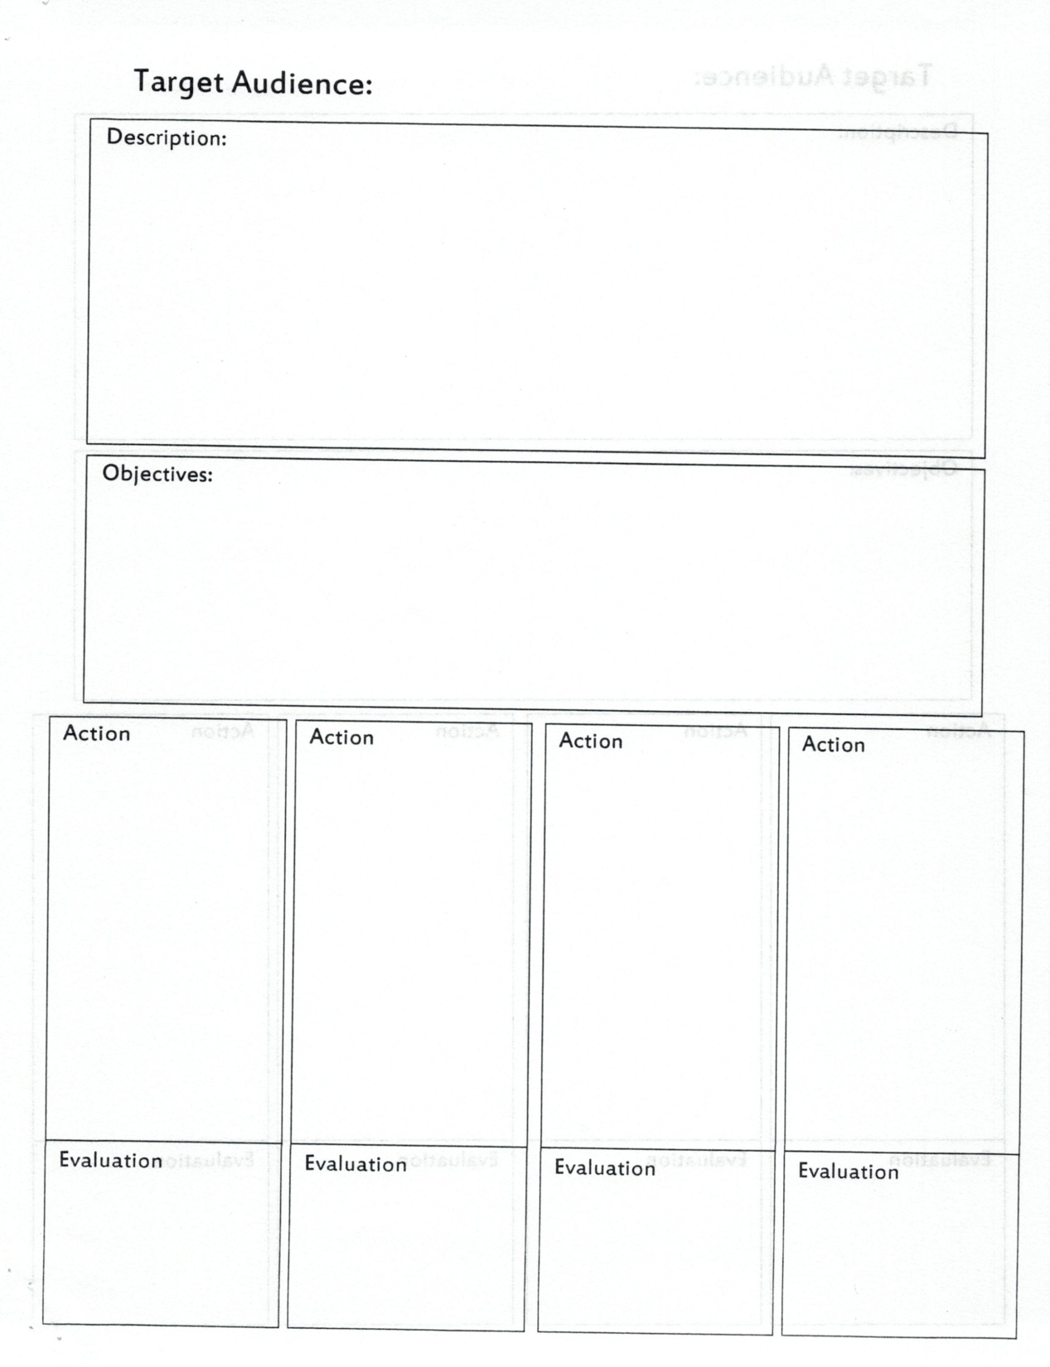

Slide 9
In Search of Santa
Web Search
Craigslist
Booking Sites
GigSalad.com
GigMasters.com
Thumbtack.com
Booking Agency
Tim Connaghan
Susen Mesco
Nationwide Santas
Local Agents
Classified Ads
Referrals
Directories
Yellow Pages
SantaClausGuide.com
Organizations
Chamber of Commerce
IBRBS, Local Groups
Personal Contact
Connected Businesses
Venues
DJs
Photographers
Caterers

Slide 10
In Search of Customers
Past Clients
1st Bookings
Thank You
Referrals
Prospects
2nd Bookings
Referrals
Target Audiences
Personal Visit
Direct Mail
Phone Call
Friends & Family
Connected Businesses
Promotional Materials
Commission
Networking
Business Groups
Organizations
Community Events
Speaking
Volunteer
Social Media
Media

Slide 11
Santa’s Marketing Tool Kit
Name
Domain Name
GoDaddy
eMail
Profile
Photos
Contact Lists
Business Cards
Give-aways
Brochure
Website
Flyers
Promo Letters
Social Media
Classifieds
Prospect Letter
Contract
Thank You

Slide 12
Written Santa Profile
Focus on Priorities
Who Your Are
Summary
Experience
Education
Credentials
What You Do
Services
Events
Skills
Resources
Professionalism
How to Use It
Excerpt Sections
Tailor to Targets
Boilerplate
Where to Use It
Website
Social Media
Booking Sites
Brochure
Applications
Promo Materials
Press Releases
Directories

Slide 13
Written Santa Profile
Focus on Priorities
Who Your Are
Summary
Experience
Education
Credentials
What You Do
Services
Events
Skills
Resources
Professionalism
How to Use It
Excerpt Sections
Tailor to Targets
Boilerplate
Where to Use It
Website
Social Media
Booking Sites
Brochure
Applications
Promo Materials
Press Releases
Directories

Slide 14
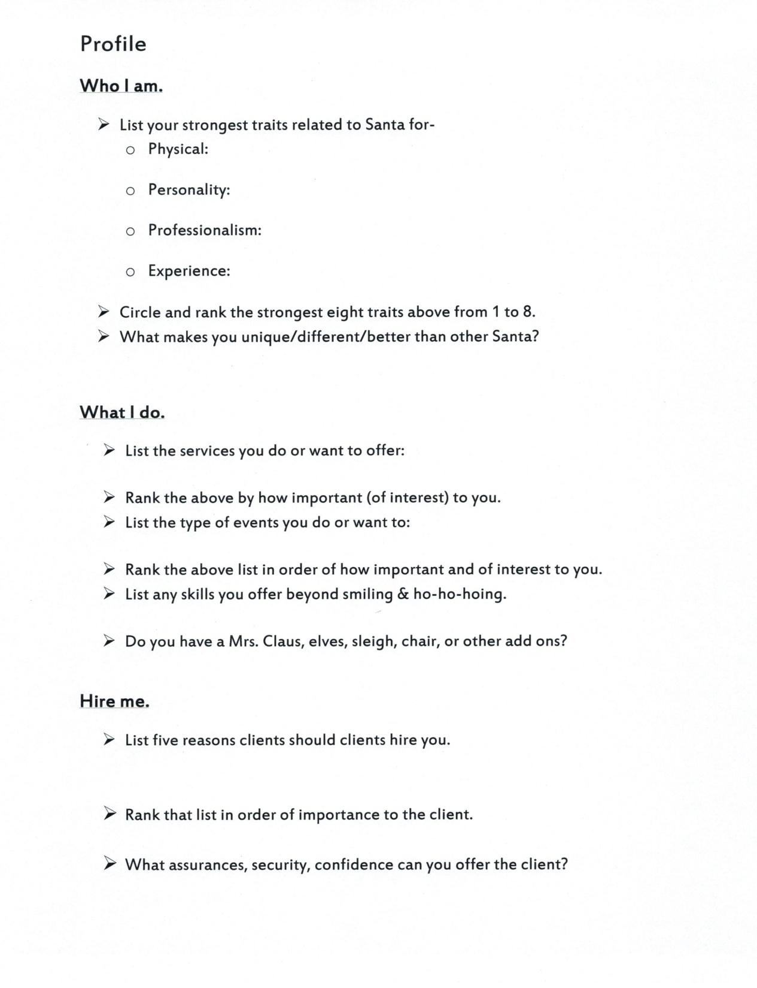

Slide 15
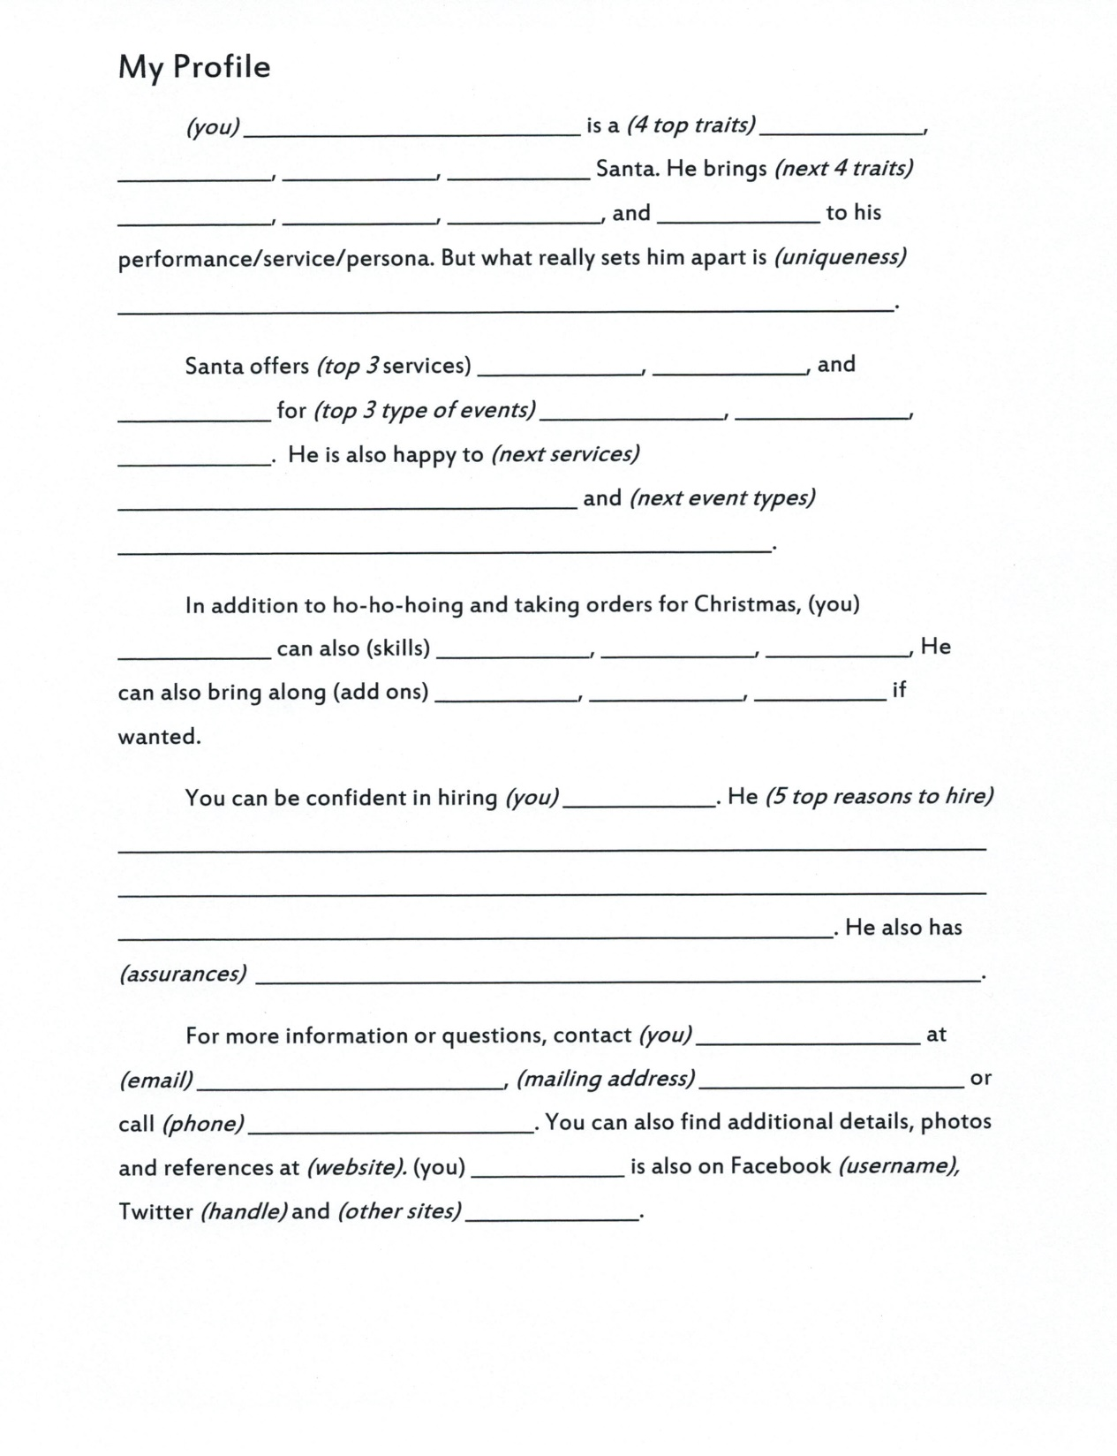

Slide 16
Promotional Photos
“A Picture is Worth 1000 Words”
What Do These Photos Say?

Slide 19
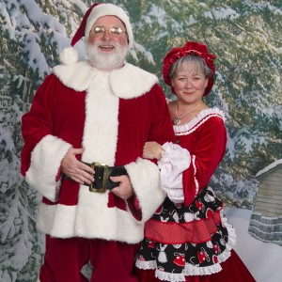
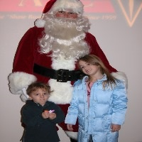

Slide 20
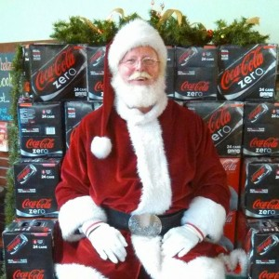
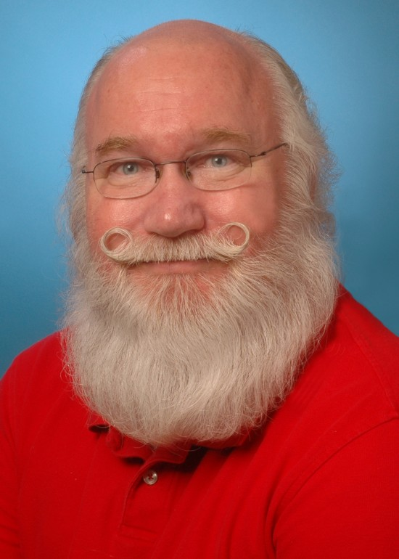
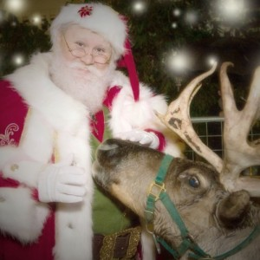
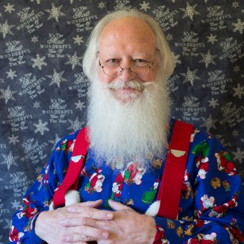

Slide 22
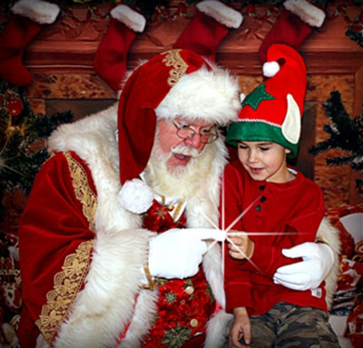
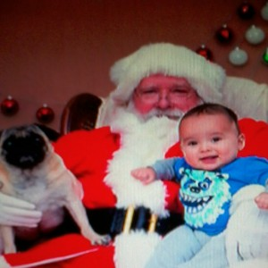
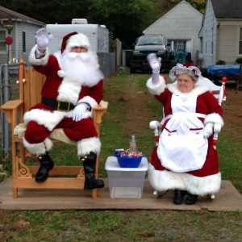
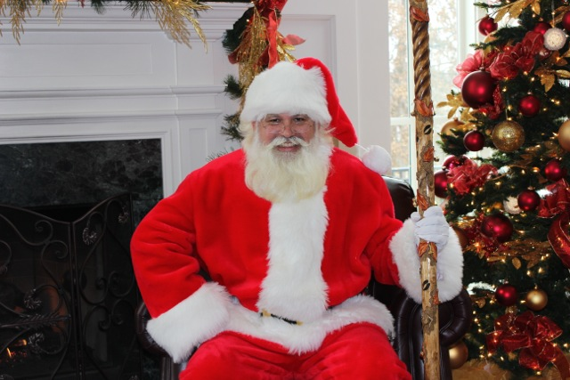

Slide 23
Promotional Photos
“A Picture is Worth 1000 Words” What Should Your Photos Say?
Authentic Look
Quality Suit
Jolly Elf
Professional
Connects Children
Energetic
Different Than Others
Where to Use Them
Website
Social Media
Booking Sites
eMails
Brochure
Promo Materials
Press Releases
Directories

Slide 24
Create Great Photos
Edited Quality Image
Promote Yourself
Entertain
Captivate
Inspire
Unique Poses
Exude Energy
Show Character
Style & Class
- From Susen Mesco
Primary Portfolio
Close Up of Face in HD Makeup
Bust Doing Something Active
Head to Toe in “Dress Reds”
Action Shot with Child (face not seen)

Slide 25
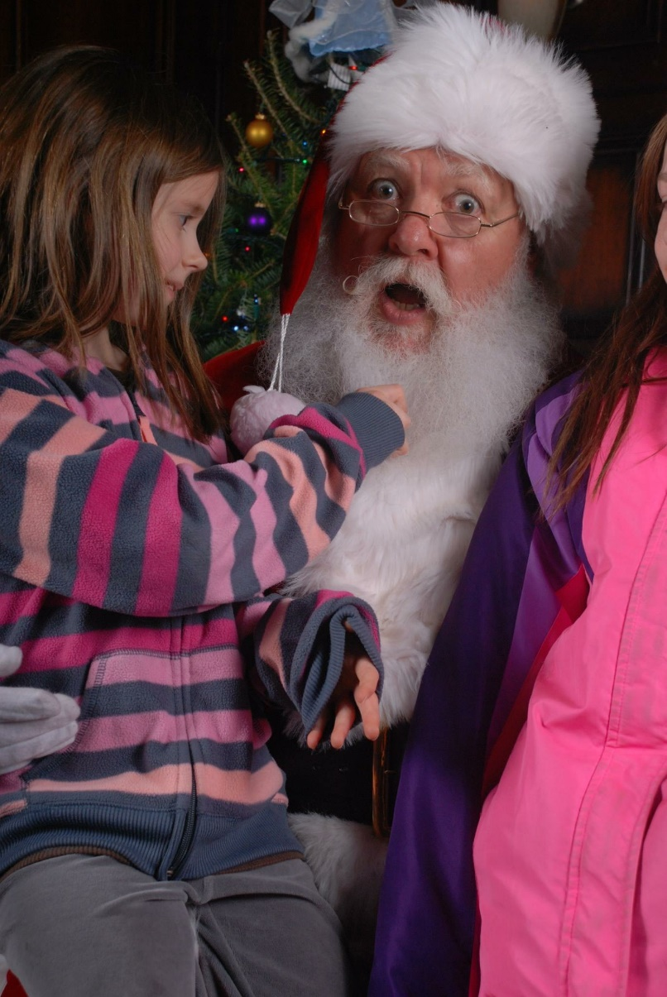

Slide 26
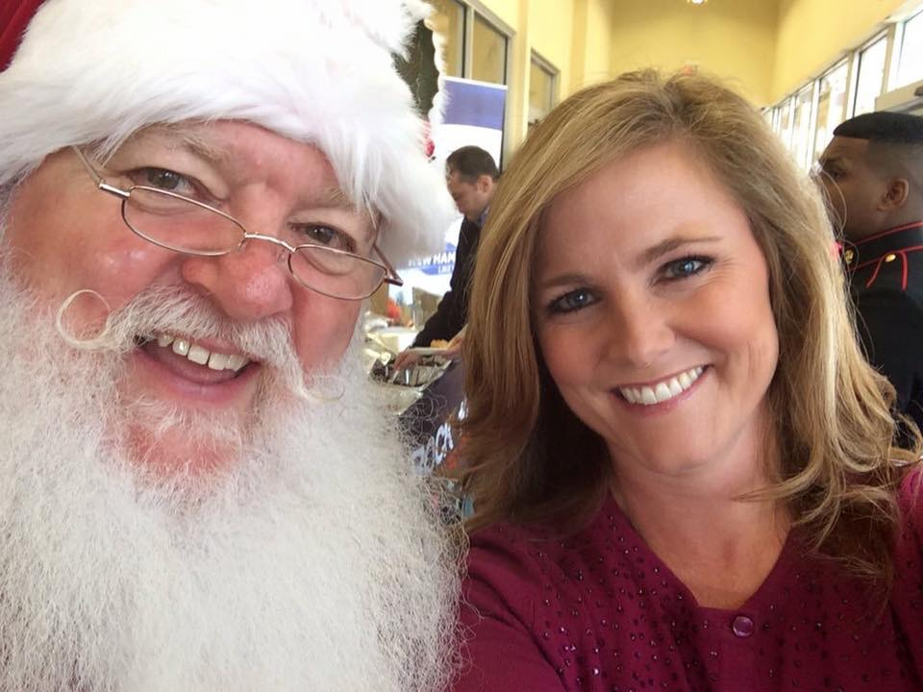
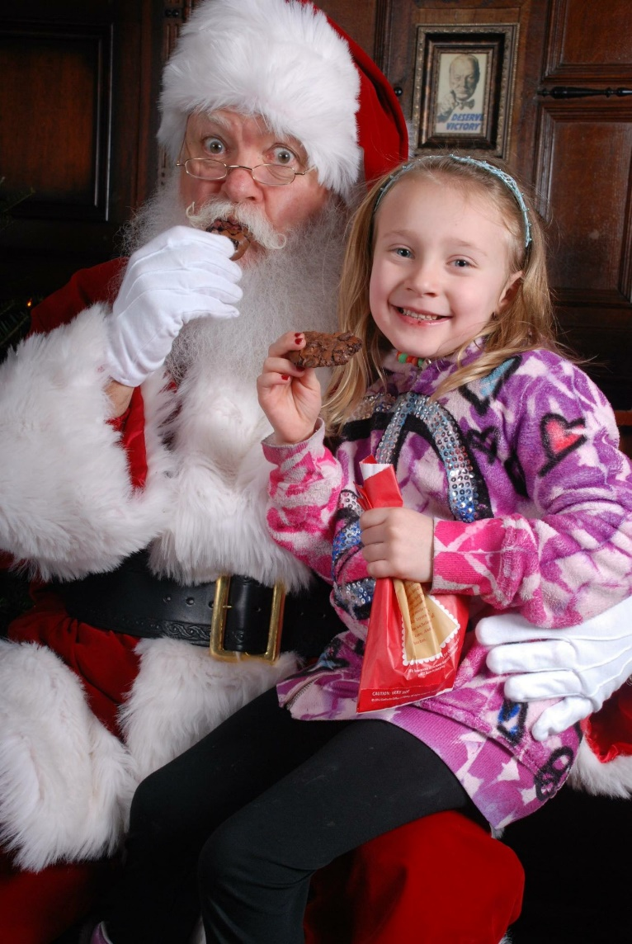
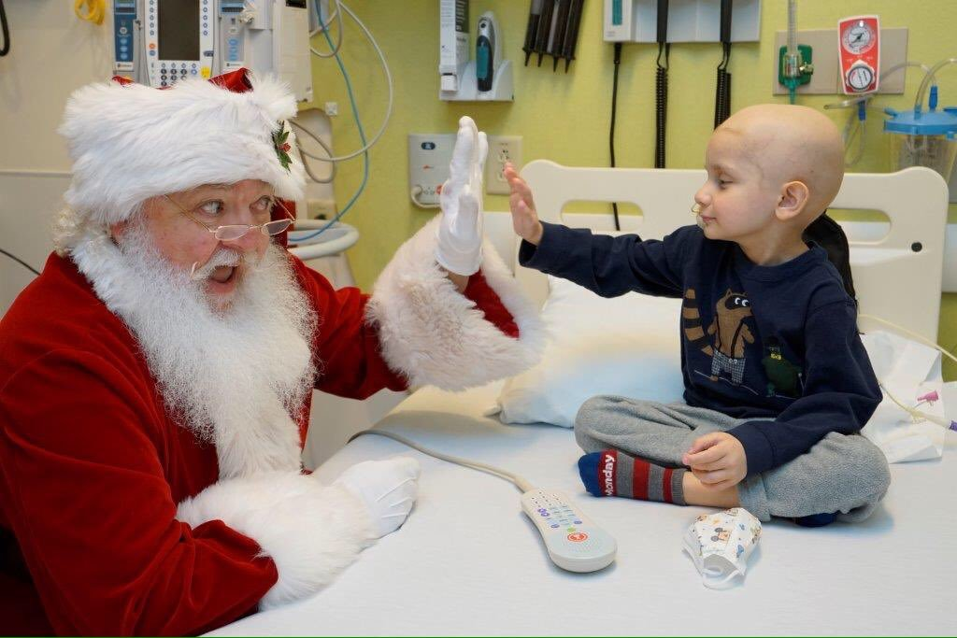

Slide 27
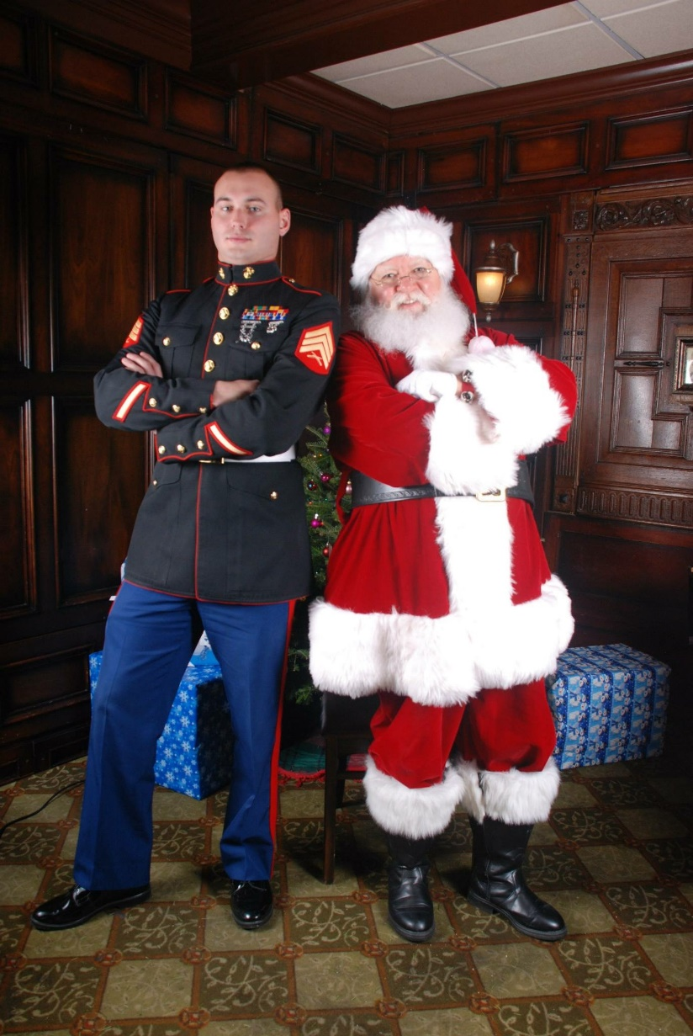
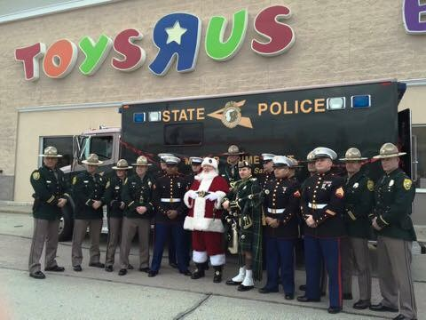

Slide 28
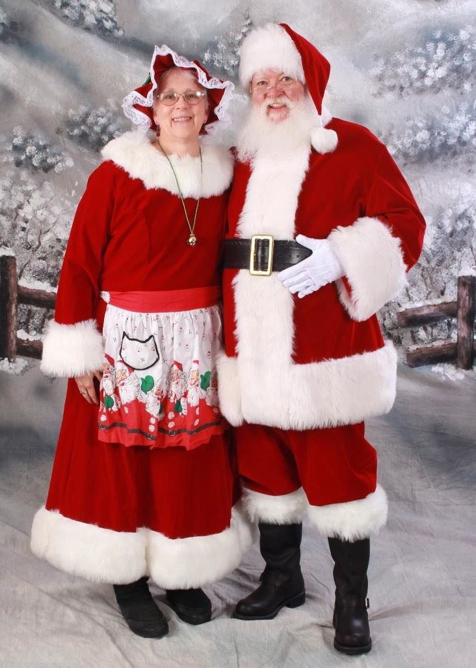
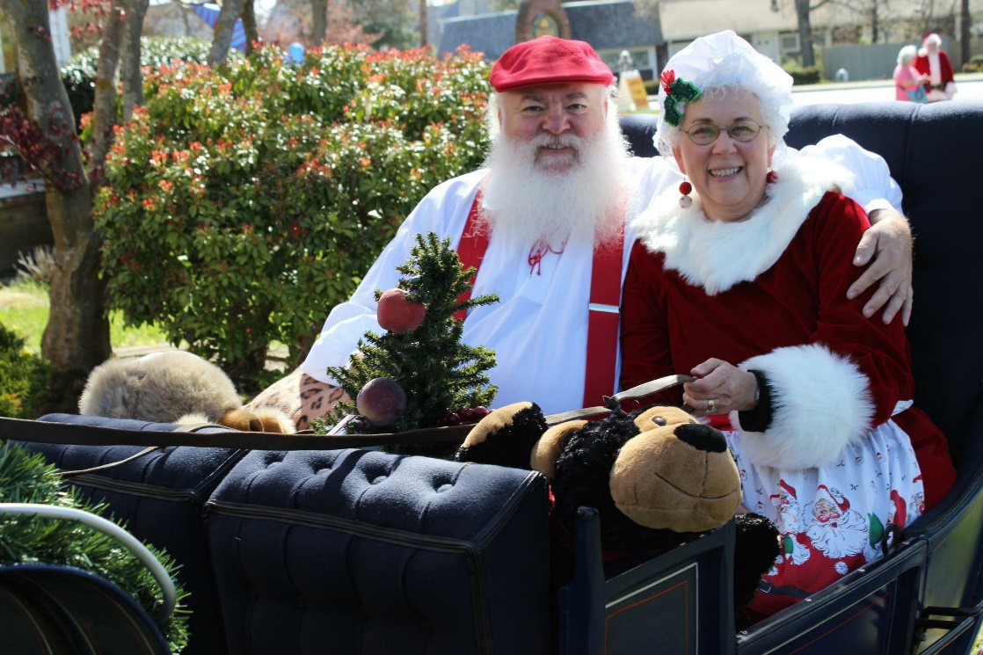

Slide 29
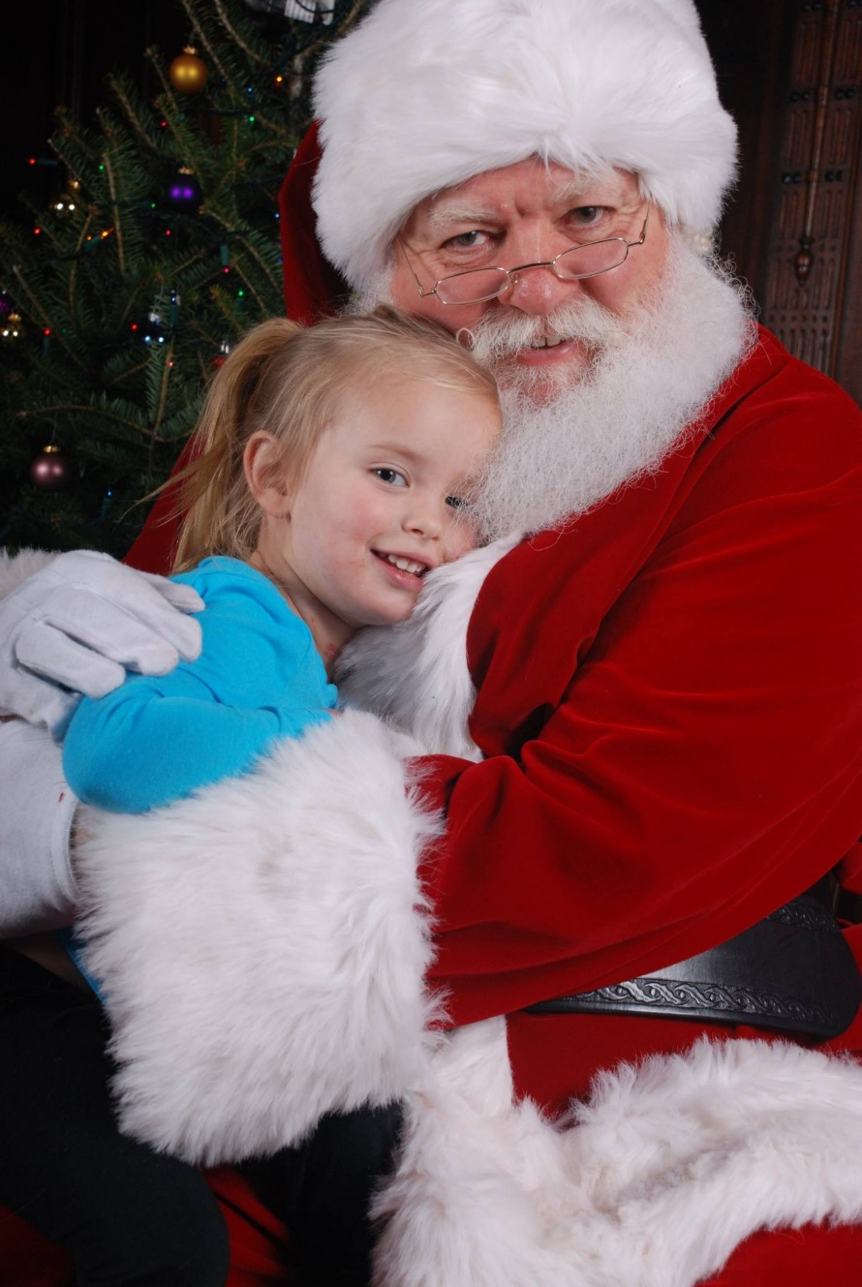

Slide 30
Business Cards
Legible
Font Style & Size
Photo Overprints
Use Both Sides
Purpose
BUSINESS Card
Contact Information
Take Away
Referrals
Not an Advertisement
Not Child Gift
Should Include:
Name of Real Person
Company Name*
Location
Contact Options
Email
Address
Phone Number(s)
Information Source
Quality Photo*

Slide 31
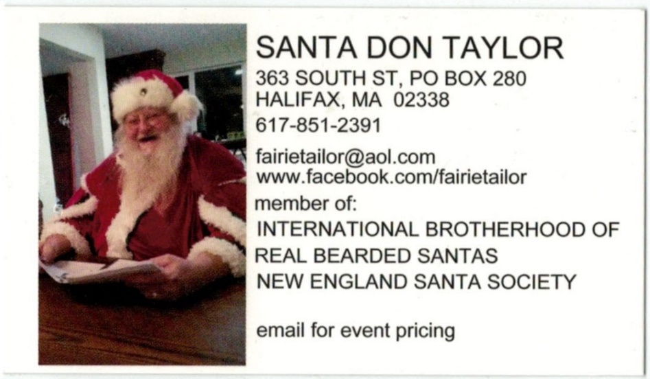
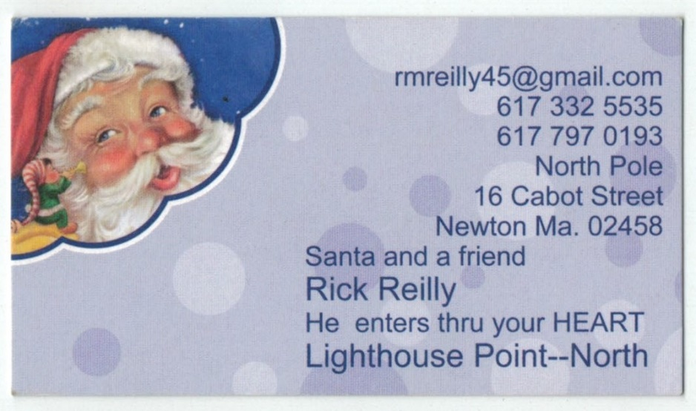

Slide 32
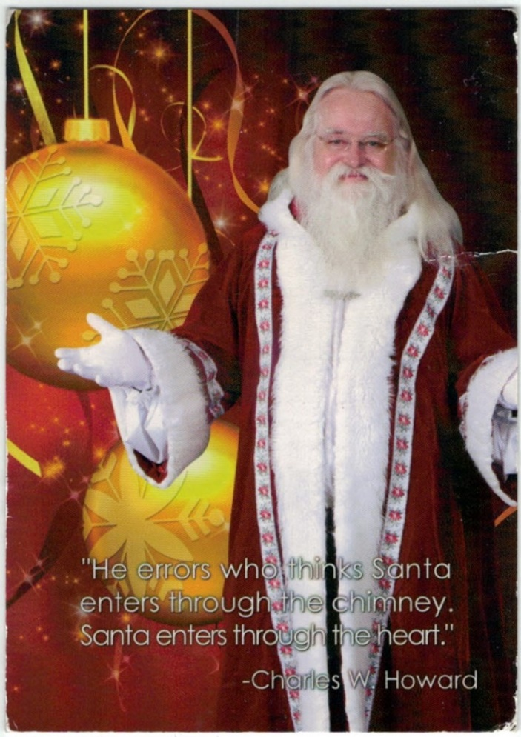
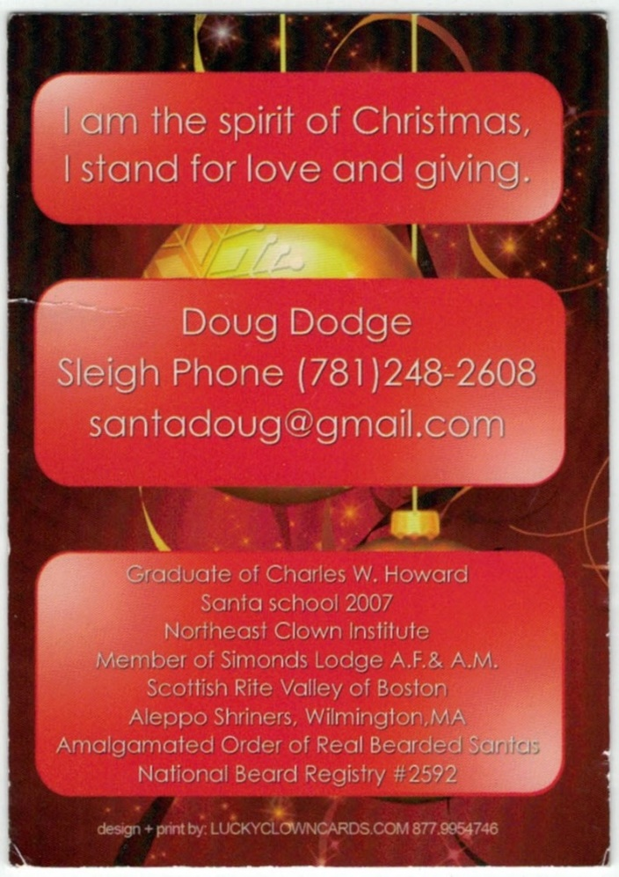

Slide 33
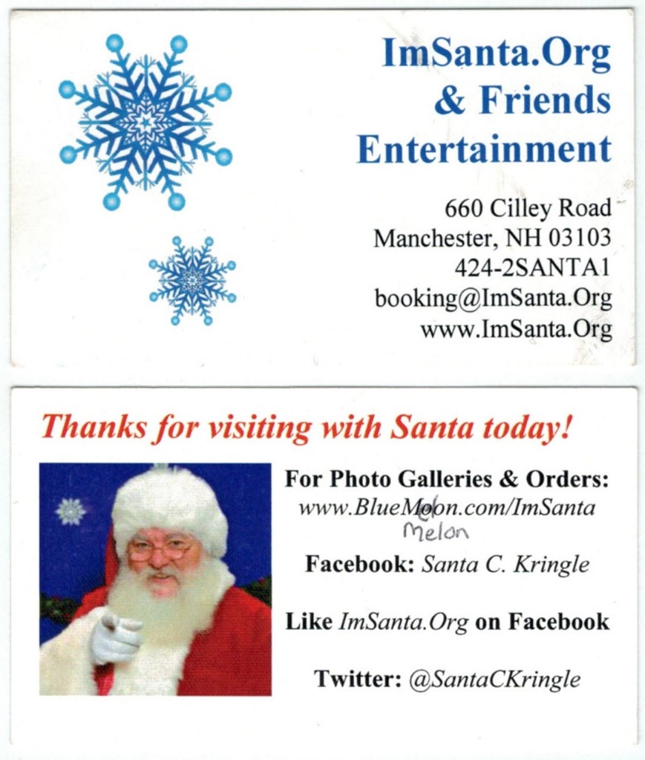
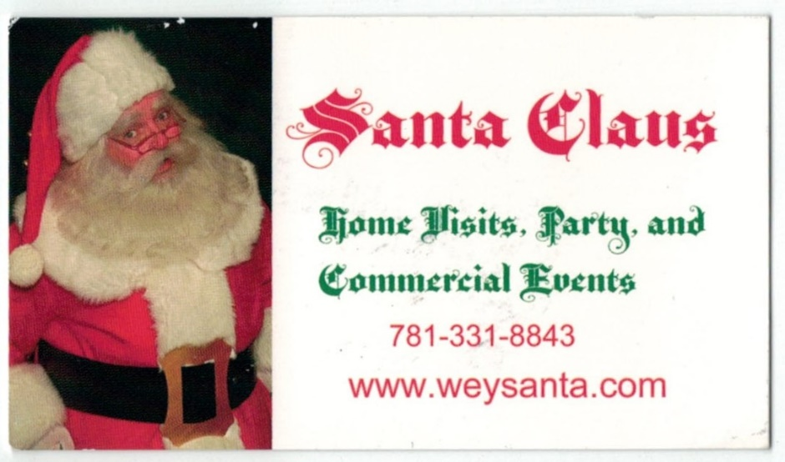

Slide 34
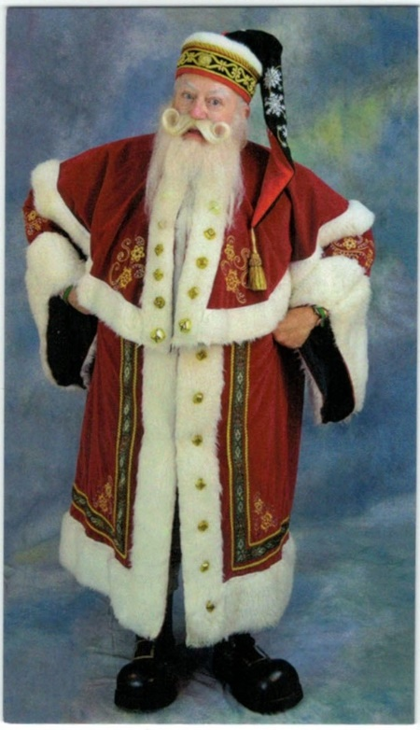

Slide 35
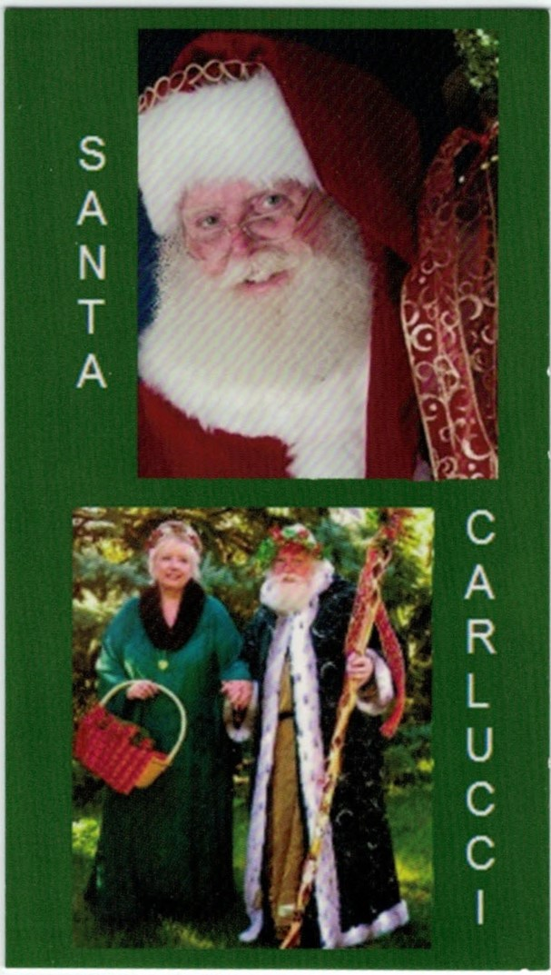
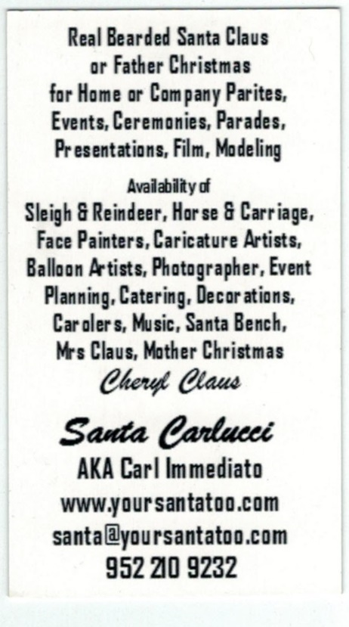

Slide 36
Status Updates
Photos & Videos
Events
Messages & Chats
Personal Profile
Friends
Followers
Broad Visibility
Groups
Facebook Page
Likes
Followers
Limited Visibility
Reviews
Ads & Boosts

Slide 37
Page Content
Profile
Detailed & Specific
Contact Information
Keywords
Quality Photos
Photo Albums
Profile Photos
Action & Posed
Event Albums
Notes
Background & Experience
Testimonials
Programs & Services
Articles
Events
Public & Private
Invitations
Photos

Slide 38
Build A Following
Invite Friends
Import Contacts
LIKE Link
Website
Emails
Brochure
Flyers
Like to be Liked
Target Audiences
Related Pages
Followers & Friends
Like
Reply
Comment
Share
Be Attractive
Useful Information
Soft Sell
Visually Appealing
Unoffensive

Slide 39
Using Paid Promotion
Boost Posts
Select Posts
Followers (& Friends)
Target Audience
Location
Age
Gender
Interests
Budget
Duration
Ad Campaign
Campaign Template
Objective Options
Target Audience*
Budget – Daily or Lifetime
Schedule
Ad Creation
Media & Text
Gadgets, Forms, etc.
Detailed Analytics

Slide 40
Strategies for Success
Post Regularly
Pre & Post Events
Activities
Advice
Hot Toys
Unusual Requests
Humor
Photos & Videos
Links
Events
Be Visible
Like
Reply
Comment
Share
Interconnectivity
Twitter & Instagram
Website
Experiment
Monitor

Slide 41
Merry Christmas
Dan Greenleaf
ImSanta.Org,
Manchester, NH
Santa@ImSanta.Org
424-2SANTA1
www.Facebook.com/ImSanta.Org
www.Facebook.com/SantaDanGreenleaf
Twitter: @SantaCKringle
LinkedIn: Santa Dan Greenleaf
www.SantaCKringle/tumblr.com

